Slide 1
Research Computing Update
May 2021

Slide 2
HPC Resources
New HPC Procurement via ANKABUT
Created identity management system and in process of integrating it with cluster software.
This has caused more delays to launch
Masdar Datacentre resources HPC Cluster
Big push to vacate Masdar Datacentre, indications are that this will happen in late June or early July.
Continuing to work with IT/Ankabut to vacate as soon as possible
SAN HPC Cluster
Continueing to provide KU researches access to cluster, though we expect to shutdown access soon.
In process of transferring research and HPC data from ADRIC datacentre.

Slide 3
Resource Utilization

Slide 4
KU Cluster core distribution

Slide 5
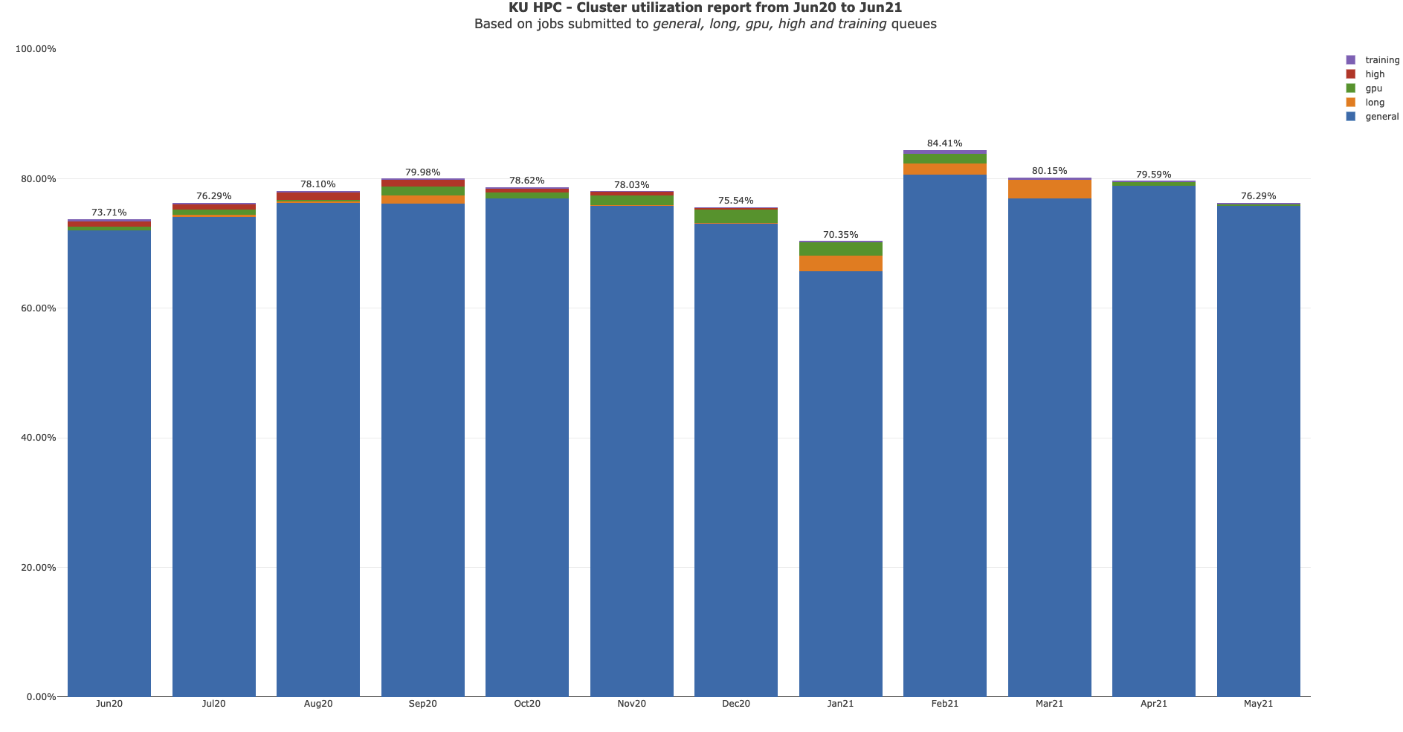

Slide 6
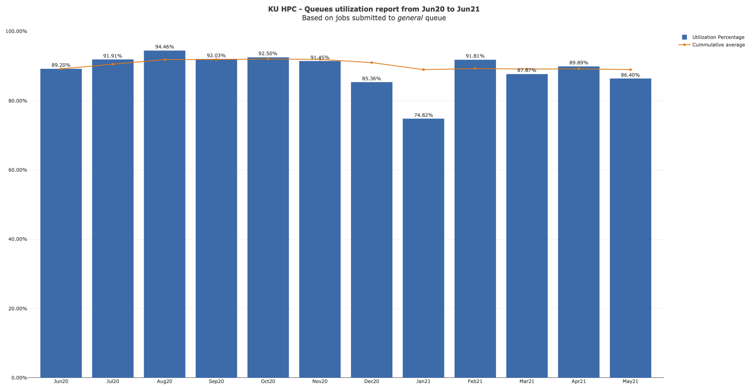

Slide 7
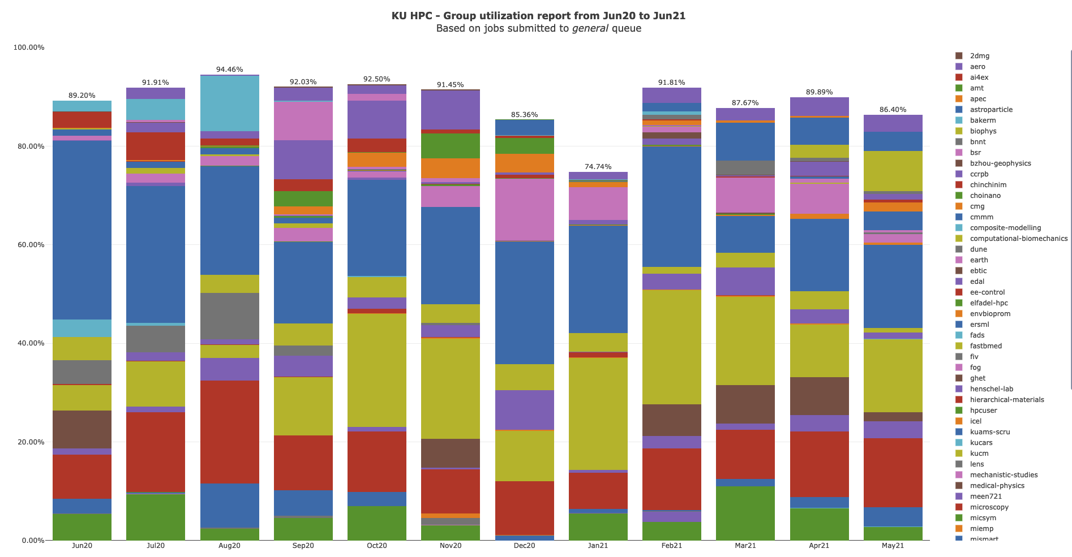

Slide 8
KU HPC Group Utilization for May 2021.
Groups were created under PI names, some of which have left KU, though the group remains. There is no link directly between HPC accounts and HR data. That is being worked on for the new cluster.

Slide 9
PI Cluster core distribution

Slide 10
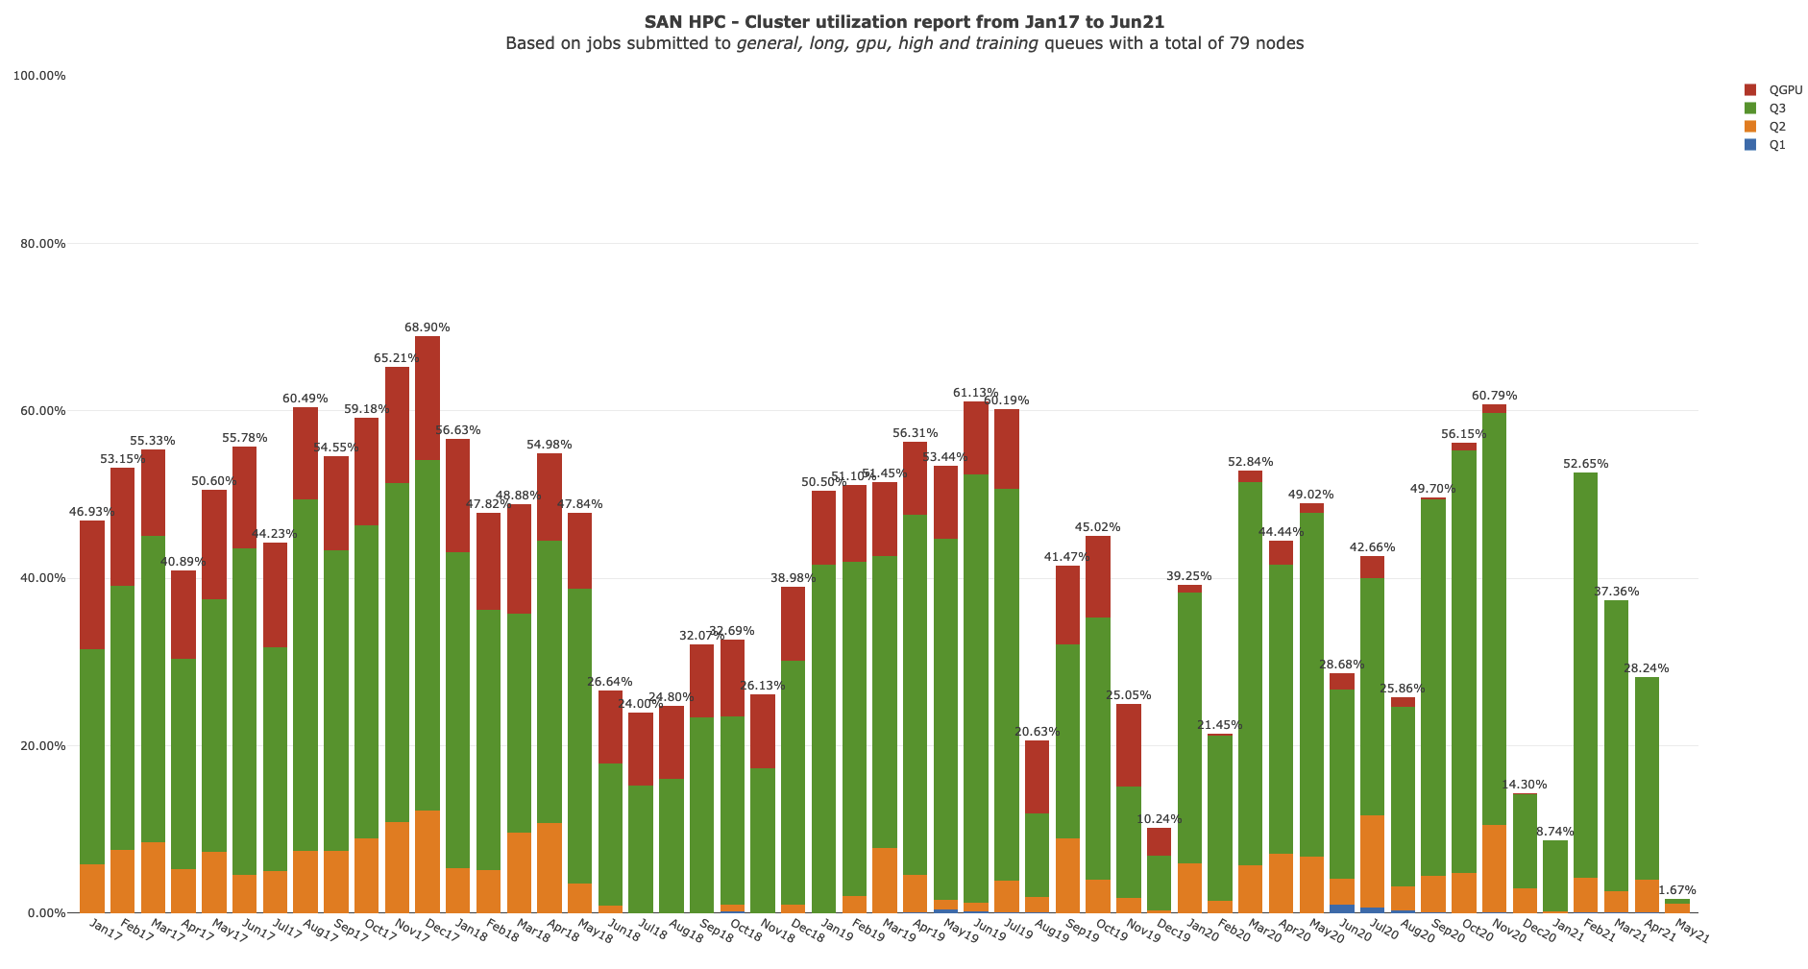

Slide 11
Status of KPI’s

